Slide 1
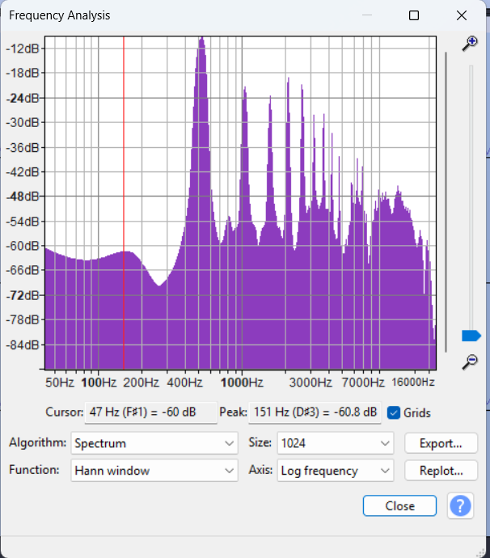
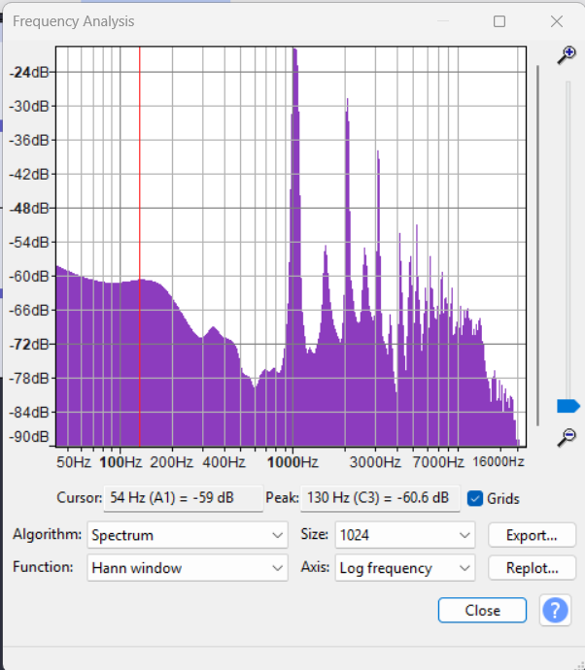
Lecture 11
576728616

Slide 2
Sonic Boom Setup
v_{s}
θ
s_{n}
s_{o}
s₁
s₂
s₃
s₄
v_{s}t

Slide 3
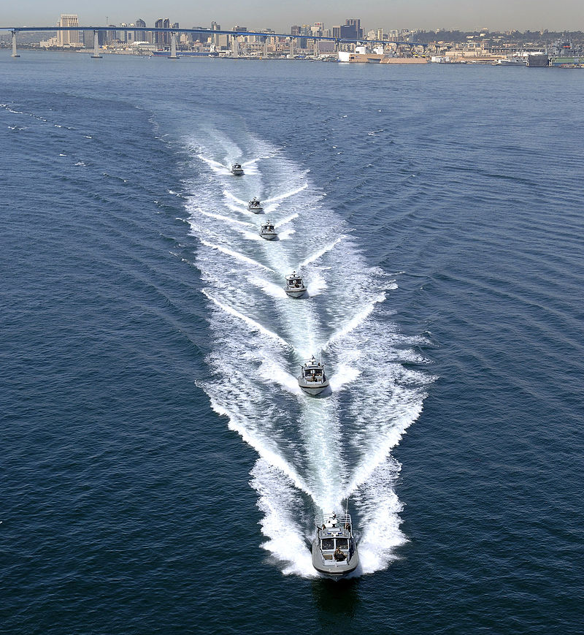

Slide 4
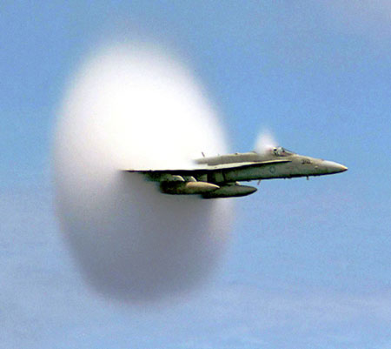

Slide 5
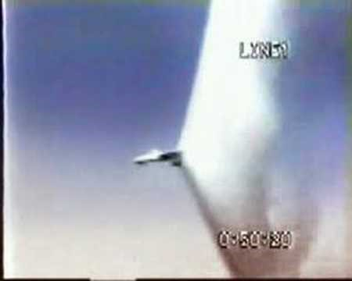

Slide 6
But, what if the waves aren’t sinusoidal?

Slide 7

Flour
Sugar
Eggs
Chocolate Chip Cookies
Chocolate Chips
Baking Powder
Margarine
vanilla

Slide 8
Flour
Sugar
vinegar
Chocolate cake
cocoa
Baking Soda
oil
vanilla

Slide 9
Chocolate Chip Cookies
Mass of ingredient
Flour
Sugar
Eggs
Margarine
Vanilla
Chocolate Chips
Baking Powder

Slide 10
440Hz
880Hz
1320Hz
Trumpet A
1760Hz
2200Hz
2640Hz
3080Hz

Slide 11
440Hz
1320Hz
Clarinet A
2200Hz
3080Hz

Slide 12
Trumpet A
Amplitude of Partial
440Hz
880Hz
1320Hz
2640
3080
1760Hz
2200Hz

Slide 13
Clarinet A
Amplitude of Partial
440Hz
880Hz
1320Hz
2640
3080
1760Hz
2200Hz

Slide 16
Question 223.9.3
If a trumpet sound is made of many frequencies, which frequency gives the sound it’s musical note?
The fundamental
The second harmonic
The third harmonic
The fourth harmonic

Slide 17
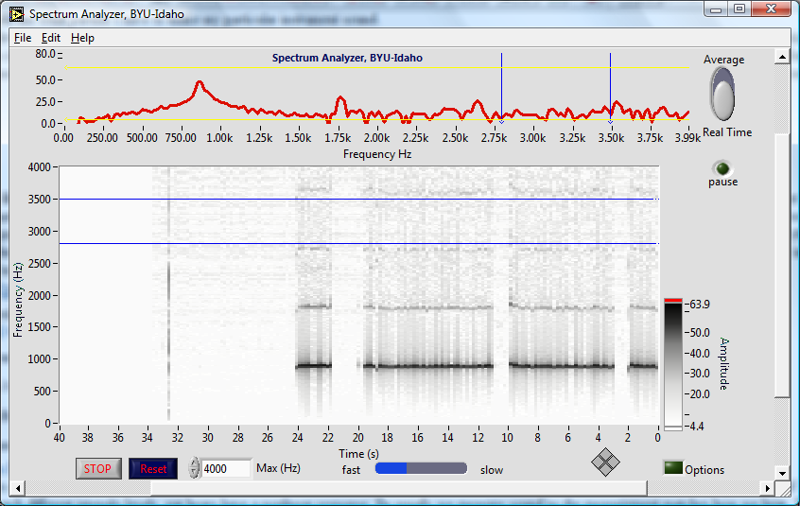
Peaks show partials

Slide 18
Strip chart also shows partials, darker black means higher peak
It is like looking at the graph above, but from above, and repeated for each second of playing

Slide 19
Notice that there are non-harmonic partials in this instrument too!

Slide 20
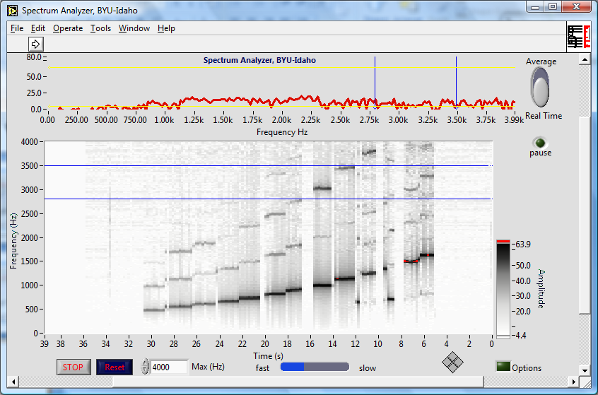
Bamboo six holed flute

Slide 21
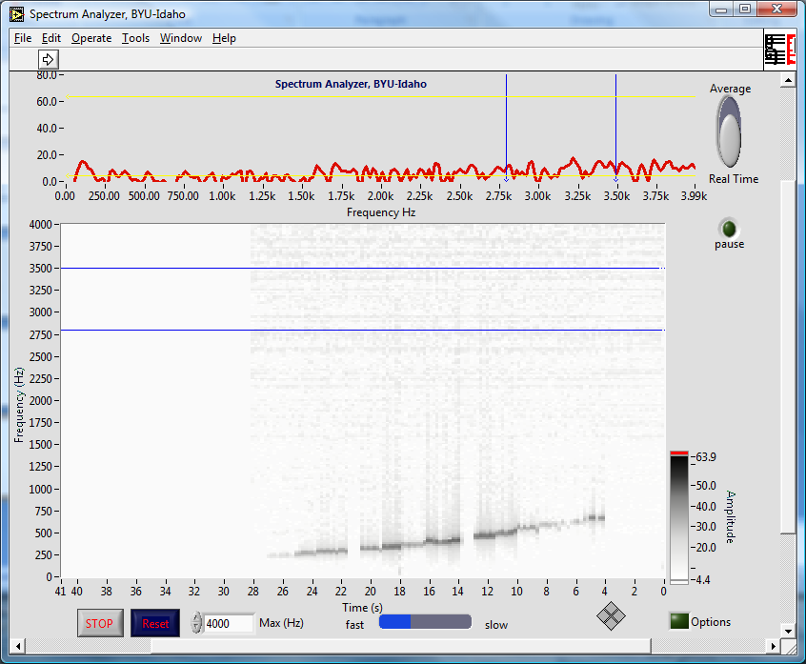
Ocarina

Slide 22
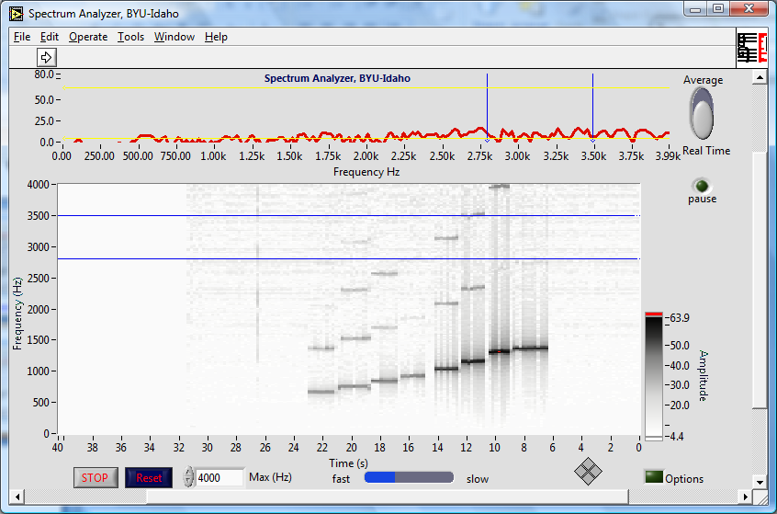
Recorder

Slide 23
Recorder

Slide 24
Question 223.9.3.1
We can make a sound spectrum to see what frequencies are in a complex sound. Are light signals also made of multiple frequencies?
Yes
No
This is all crazy

Slide 25
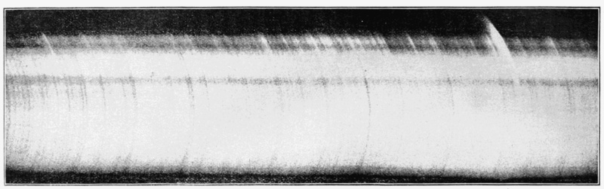
Application: Light Spectra

Slide 26


Slide 27
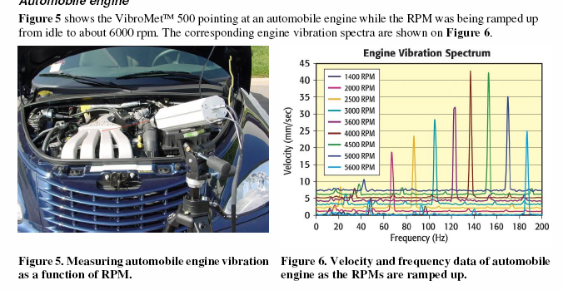
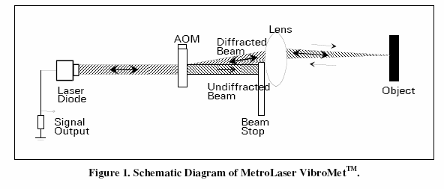
Application: Industrial Monitoring

Slide 28
Application, Vibrometry Target ID

Slide 29
Example: Square Wave

Slide 30
Example: Square Wave

Slide 31
Example: Square Wave, More Terms

Slide 32
Example: Square Wave

Slide 33
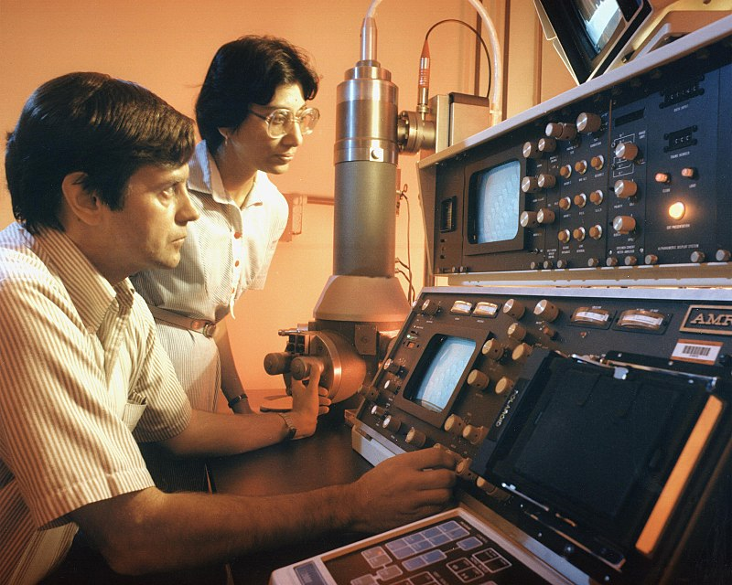
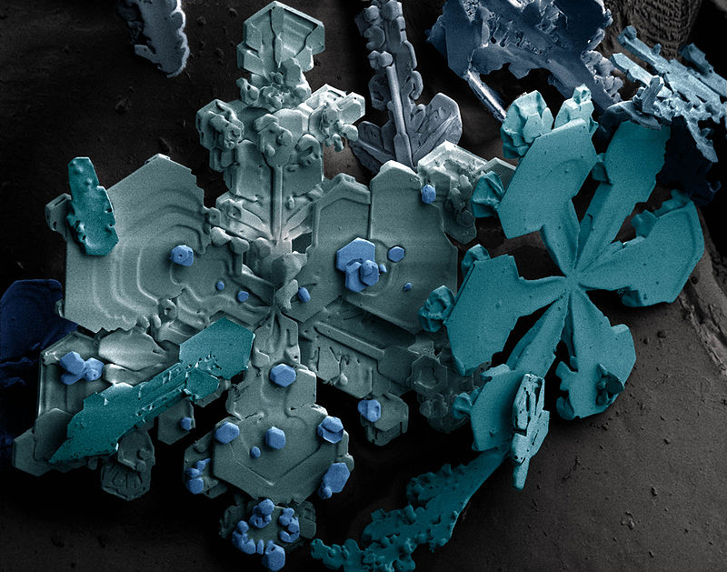
Electron Source
Condenser Lenses
Aperture
Sample
Objective Lens
Aperture
Projective Lens

Slide 34
Question 223.9.3.2
If I make a wave signal last for less time, this will cause its frequency uncertainty to
Increase
Decrease
Stay the same
Explode

Slide 36
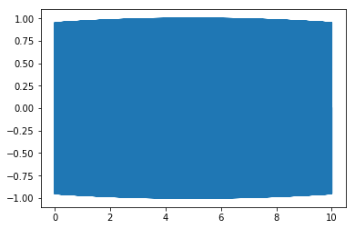
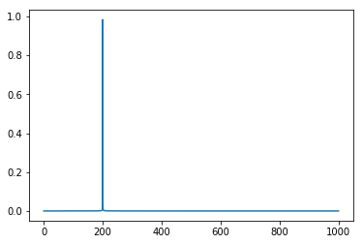
Time in seconds
Frequency in Hz
10s, 200Hz

Slide 37

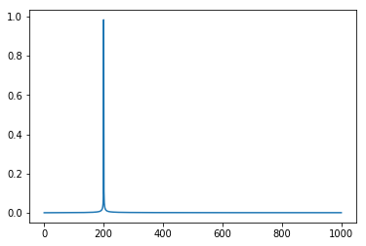
Time in seconds
Frequency in Hz
1sec, 200hz

Slide 38
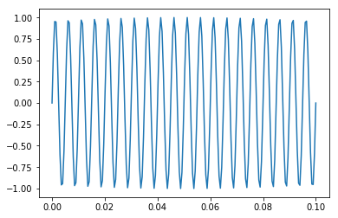
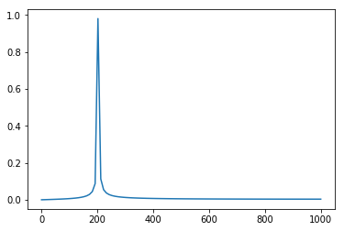
Time in seconds
Frequency in Hz
0.1 sec, 200hz

Slide 39
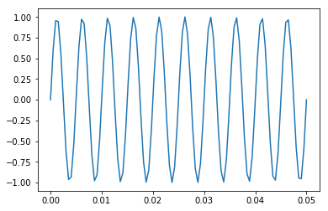
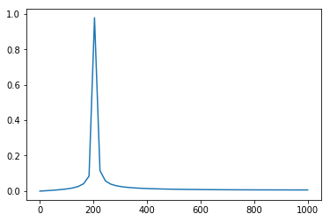
Time in seconds
Frequency in Hz
0.05 sec, 200hz

Slide 40
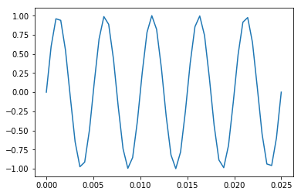
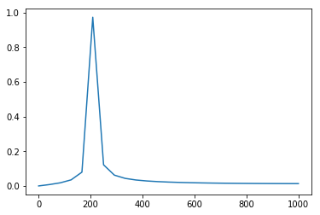
0.025 sec, 200hz

Slide 41
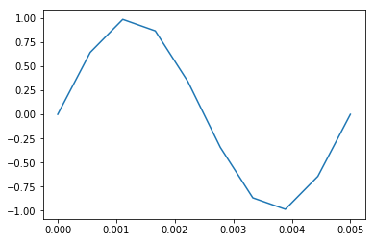
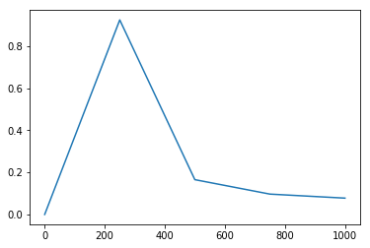
￼
Time in seconds
Frequency in Hz
0.005 sec, 200hz

Slide 43
End

Slide 44
Question 223.10.1
Light is a …
Electromagnetic Wave
Particle
Neither
Both

Slide 45
Question 223.10.2
The energy of a photon is proportional to
The wavelength
The period
The frequency
π

Slide 46
Question 223.10.3
The speed of light is always constant
True
False

Slide 47
Question 223.10.4
Can anything go faster than light?
Yes
No
Only at CERN

Slide 48
The Nature of Light
Before the beginning of the nineteenth century, light was considered to be a stream of particles
The particles were either emitted by the object being viewed or emanated from the eyes of the viewer
Newton was the chief architect of the particle theory of light
He believed the particles left the object and stimulated the sense of sight upon entering the eyes

Slide 49
Nature of Light – Alternative View
Christian Huygens argued that light might be some sort of a wave motion

Slide 50
Young’s Contribution
Thomas Young (1801) provided the first clear demonstration of the wave nature of light
He showed that light rays interfere with each other
Such behavior could not be explained by particles

Slide 51
Modern Scriptural Comments on Nature of Light
In September of 1832 Joseph Smith received a revelation that said in part :
For the word of the Lord is truth, and whatsoever is truth is light, and whatsoever is light is Spirit, even the Spirit of Jesus Christ. And the Spirit giveth light to every man that cometh into the world; and the Spirit enlighteneth every man through the world, that hearkeneth to the voice of the Spirit. (D&C 84:45-46)

Slide 52
Modern Scriptural Comments on Nature of Light
In December of 1832 Joseph Smith received another revelation that says in part:
This Comforter is the promise which I give unto you of eternal life, even the glory of the celestial kingdom; which glory is that of the church of the Firstborn, even of God, the holiest of all, through Jesus Christ his Son---He that ascended up on high, as also he descended below all things, in that he comprehended all things, that he might be in all and through all things, the light of truth; which truth shineth. This is the light of Christ. As also he is in the sun, and the light of the sun, and the power thereof by which it was made. As also he is in the moon, and is the light of the moon, and the power thereof by which it was made; as also the light of the stars, and the power thereof by which they were made; and the earth also, and the power thereof, even the earth upon which you astand. And the light which shineth, which giveth you light, is through him who enlighteneth your eyes, which is the same light that quickeneth your understandings; which light proceedeth forth from the presence of God to fill the immensity of space---the light which is in all things, which giveth life to all things, which is the law by which all things are governed, even the power of God who sitteth upon his throne, who is in the bosom of eternity, who is in the midst of all things. (D&C 88:5-12 emphasis added)

Slide 53
More Confirmation of Wave Nature
During the nineteenth century, other developments led to the general acceptance of the wave theory of light
Maxwell asserted that light was a form of high-frequency electromagnetic wave
Hertz confirmed Maxwell’s predictions

Slide 54
Particle Nature
Some experiments could not be explained by the wave nature of light
The photoelectric effect was a major phenomenon not explained by waves
When light strikes a metal surface, electrons are sometimes ejected from the surface
The kinetic energy of the ejected electron is independent of the frequency of the light

Slide 55
e
e
e
e
Big Battery

Slide 56
zzzzzzzzzzzzzzzzzzzzzzzz
Electron
Nucleus with protons and neutrons
Electron
Particles not drawn to scale

Slide 57
Outgoing Electron
Incoming photon

Slide 58
Particle Nature, cont.
Einstein (in 1905) proposed an explanation of the photoelectric effect that used the idea of quantization
The quantization model assumes that the energy of a light wave is present in particles called photons
E = hƒ
h is Planck’s Constant and = 6.63 x 10⁻³⁴ J.s

Slide 59
Dual Nature of Light
In view of these developments, light must be regarded as having a dual nature
Light exhibits the characteristics of a wave in some situations and the characteristics of a particle in other situations
Nature prevents testing both qualities at the same time

Slide 60
Measurement of the Speed of Light

Slide 61
Measurements of the Speed of Light
Since light travels at a very high speed, early attempts to measure its speed were unsuccessful
Remember c = 3.00 x 10⁸ m/s
Galileo tried by using two observers separated by about 10 km
The reaction time of the observers was more than the transit time of the light

Slide 62
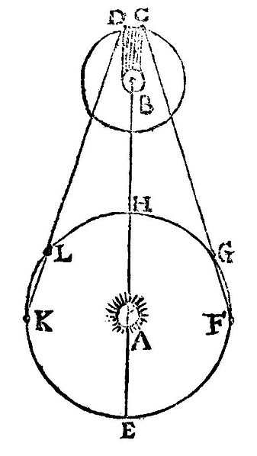
Measurement of the Speed of Light – Roemer’s Method
Ole Roemer (1675) used astronomical observations to estimate the speed of light
He used the period of revolution of Io, a moon of Jupiter, as Jupiter revolved around the sun

Slide 63
Roemer’s Method, cont.
The periods of revolution were longer when the Earth was receding from Jupiter
and shorter when the Earth was approaching
Using Roemer’s data, Huygens estimated the lower limit of the speed of light to be 2.3 x 10⁸ m/s
This was important because it demonstrated that light has a finite speed as well as giving an estimate of that speed

Slide 64
Measurements of the Speed of Light – Fizeau’s Method
This was the first successful method for measuring the speed of light by means of a purely terrestrial technique
It was developed in 1849 by Armand Fizeau
He used a rotating toothed wheel
The distance between the wheel (considered to be the source) and a mirror was known

Slide 65
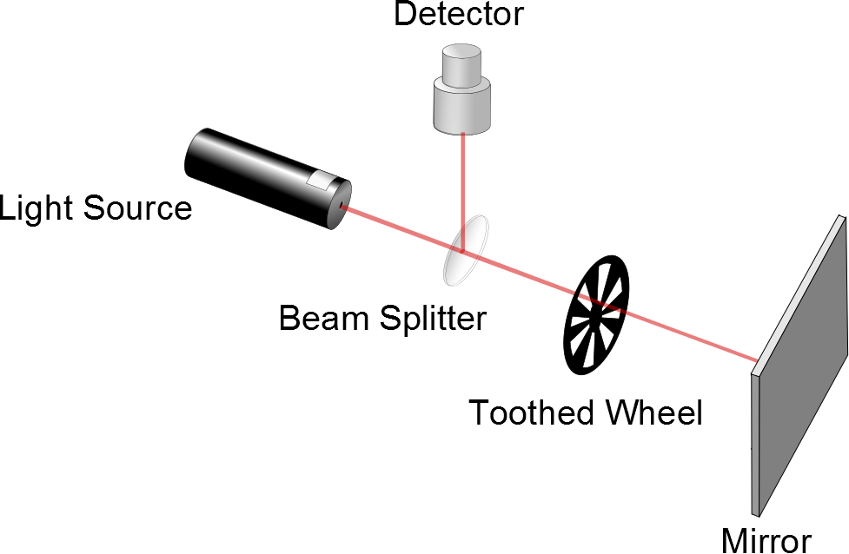
Fizeau’s Method, cont.
d is the distance between the wheel and the mirror
Δt is the time for one round trip
Then c = 2d / Δ t
Fizeau found a value of
c = 3.1 x 10⁸ m/s

Slide 66
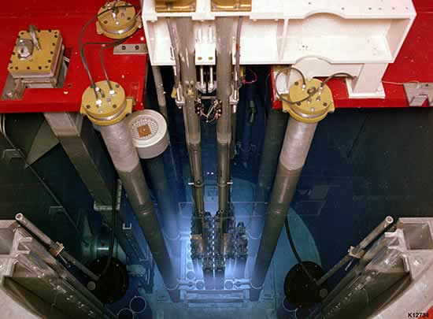
Faster than light?

Slide 67
Question 223.10.5
If you see a bright fringe in a “Young’s Experiment,” the path difference from the fringe to the slits must be equal to
And integer number of wavelengths
And integer number of half wavelengths
π
Arctan(θ)

Slide 68
Question 223.10.6
When considering order numbers, m, the possible orders are
1, 2, 3, . . .
0, 1, 2, 3, . . .
0, ±1, ± 2, ± 3, . . .
±1, ± 2, ± 3, . . .

Slide 69
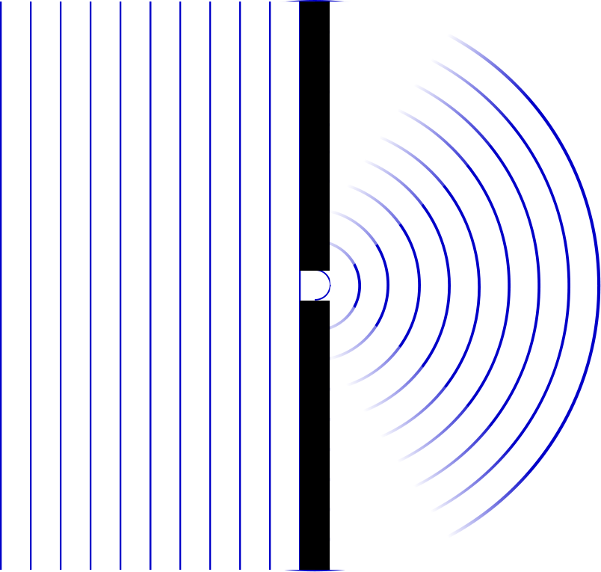

Slide 70
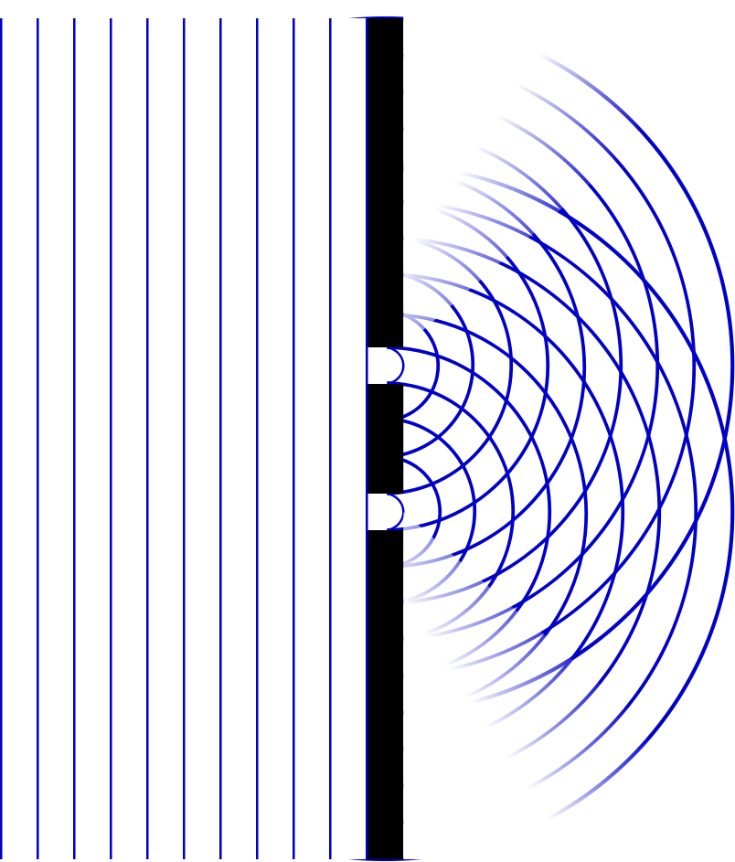

Slide 71
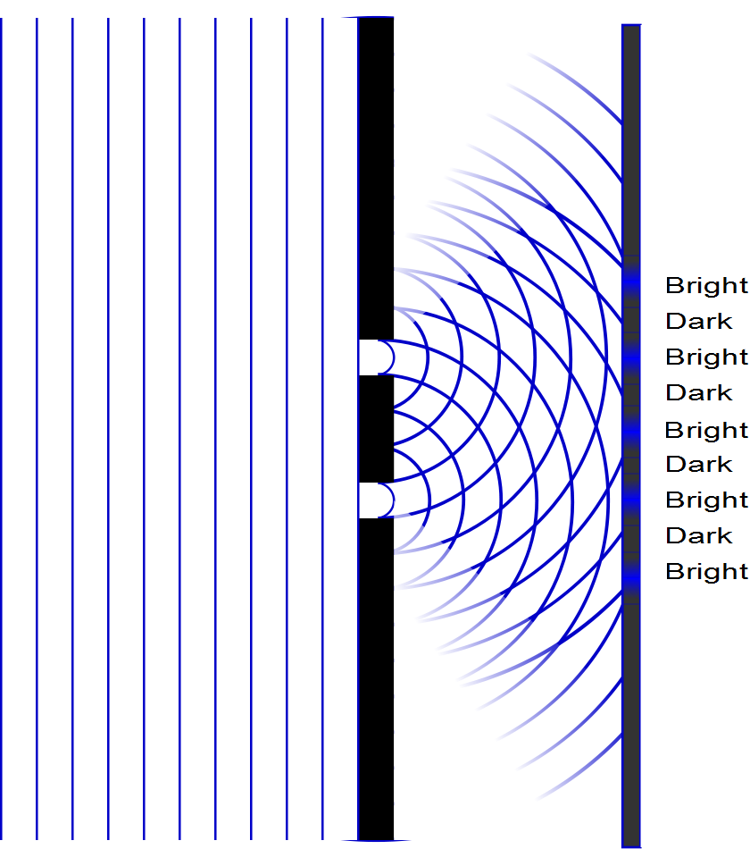

Slide 72
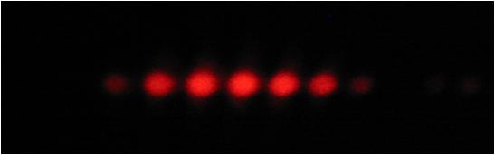

Slide 75
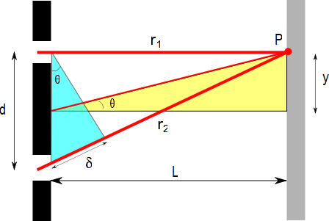
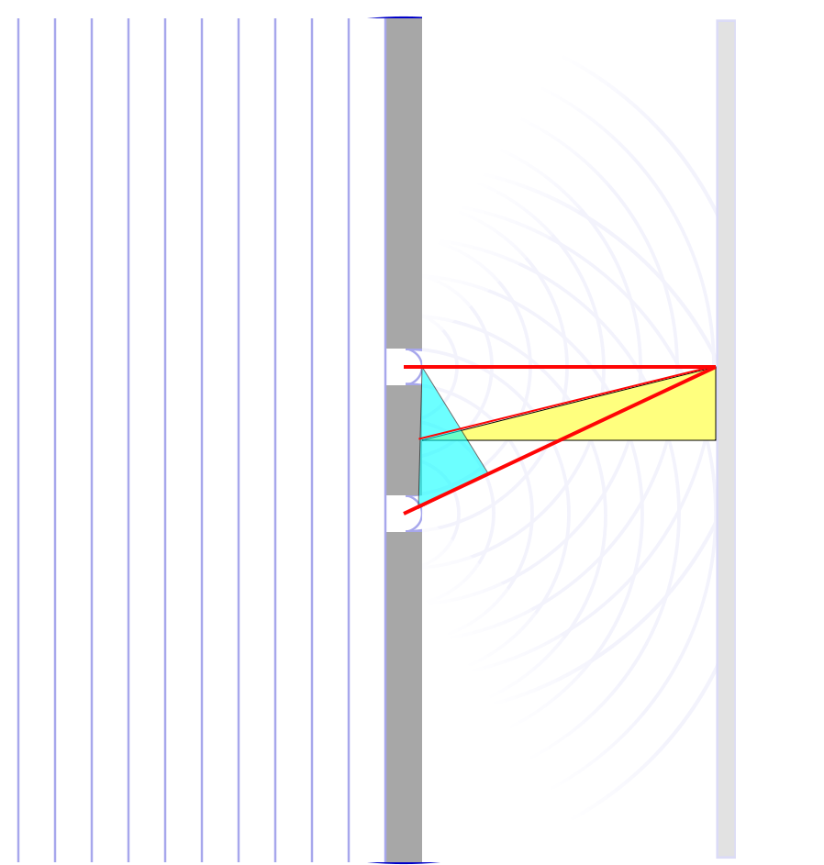

Slide 76
ConcepTest 24.3a Double Slits I
In a double-slit experiment, when the wavelength of the light is increased, the interference pattern
spreads out
stays the same
shrinks together
disappears

Slide 77
ConcepTest 24.3a Double Slits I
In a double-slit experiment, when the wavelength of the light is increased, the interference pattern
spreads out
stays the same
shrinks together
disappears
d sin θ = m λ
If λ is increased and d does not change, then θ must increase, so the pattern spreads out.

Slide 78
ConcepTest 24.3b Double Slits II
If instead the slits are moved farther apart (without changing the wavelength) the interference pattern
spreads out
stays the same
shrinks together
disappears

Slide 79
ConcepTest 24.3b Double Slits II
If instead the slits are moved farther apart (without changing the wavelength) the interference pattern
spreads out
stays the same
shrinks together
disappears
d sin θ = m λ
If instead d is increased and λ does not change, then θ must decrease, so the pattern shrinks together
Follow-up: When would the interference pattern disappear?

Slide 80
ConcepTest 24.4 Path Difference
In a double-slit experiment, what path difference have the waves from each slit traveled to give a minimum at the indicated position?
there is no difference
half a wavelength
one wavelength
three wavelengths
more than three wavelengths
Intensity

Slide 81
ConcepTest 24.4 Path Difference
In a double-slit experiment, what path difference have the waves from each slit traveled to give a minimum at the indicated position?
there is no difference
half a wavelength
one wavelength
three wavelengths
more than three wavelengths
λ
For Destructive Interference
δ = 1/2 λ, 3/2 λ, 5/2 λ, 7/2 λ, …
= (m + 1/2) λ
2λ
3λ
Intensity
λ/2
3λ/2
5λ/2
7λ/2

Slide 82
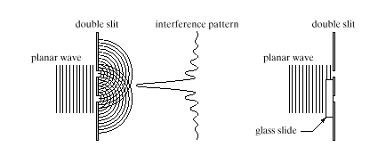
ConcepTest 24.5 Interference Pattern
pattern vanishes
pattern expands
bright and dark spots are interchanged
pattern shrinks
no change at all
An interference pattern is seen from two slits. Now cover one slit with glass, introducing a phase difference of 180° (1/2 wavelength) at the slits. How is the pattern altered?
Double slit Interference pattern
wave

Slide 83
ConcepTest 24.5 Interference Pattern
An interference pattern is seen from two slits. Now cover one slit with glass, introducing a phase difference of 180° (1/2 wavelength) at the slits. How is the pattern altered?
pattern vanishes
pattern expands
bright and dark spots are interchanged
pattern shrinks
no change at all
If the waves originating from the two slits have a phase difference of 180° when they start off, the central spot will now be dark !! To the left and the right, there will be bright spots. Thus, bright and dark spots are interchanged.
Double slit Interference pattern
wave
Follow-up: What happens when the phase difference is 90°?

Slide 86
I
Interference fringes:
due to having two slits.
φ/2
-5π
-3π
-π
π
3π
5π

